Slide 1
Protein Pow(d)er
Team: Shire Peasants 3
Authors: Mark Dzoljic, Loek van Steijn, Sebastiaan Kruize

Slide 2
Format of the presentation
1. Introduction in the casus
State Space of the problem
2. Algorithms
Random, Greedy and more
3. Results
4. Discussion
5. Conclusions
6. Q&A

Slide 3
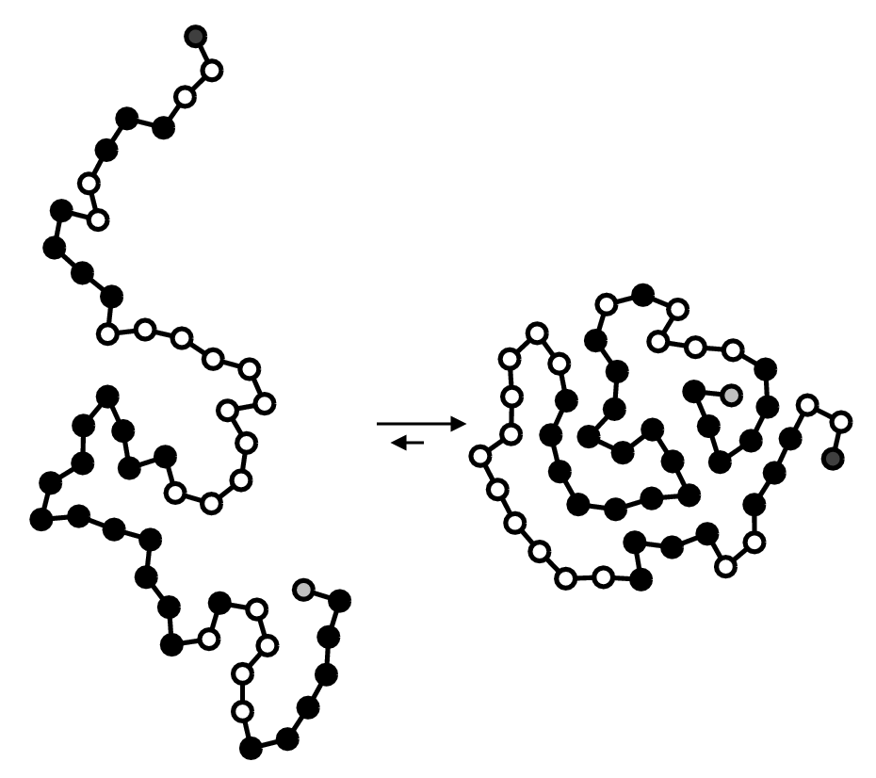
1. Introduction: Stability of proteins
Proteins fulfill numerous function inside the human body
Consist of a ’string’ of amino-acids
Faulty proteins linked to diseases such as Alzheimers or huntington
Finding “Stable” Proteins can help in the development of farmaceuticals

Slide 4
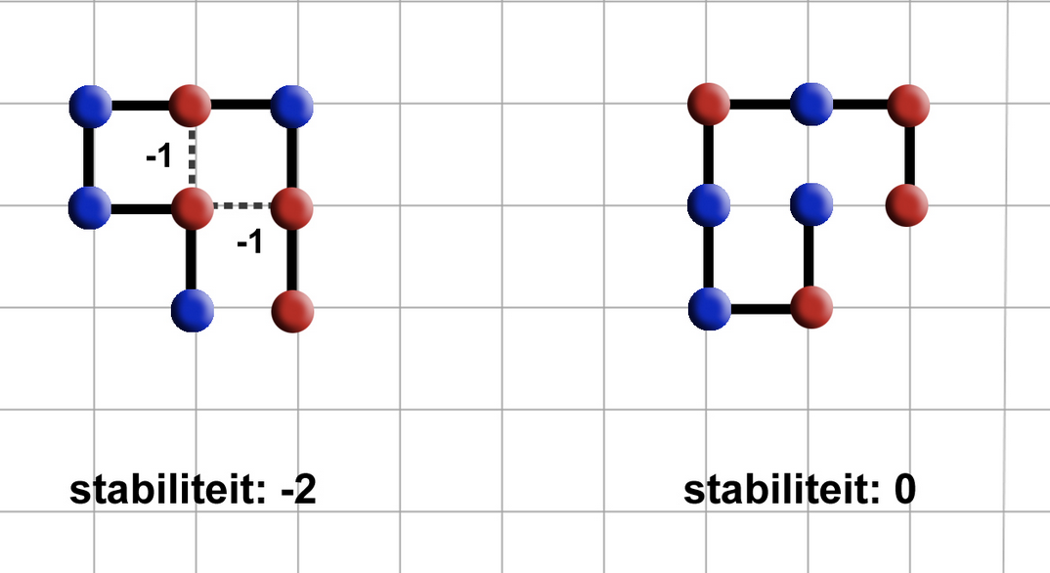
1. Introduction: Stability of proteins
Place amino-acids on a 2-D/ 3-D grid.
Amino acids can be hydrophic (Red) or Polair (Blue)
Red amino-acids can form bridges, and strengthen the stability
Goal is to find protein structures that are as stable as possible.

Slide 5
1. Case exploration and State Space
Constrained Optimization Problem
Constraints
Amino-acid string is given
All amino-acids must be used
Can not move ‘diagonally’ must move either left/right/up/down
Amino-acids cannot overlap
Optimization
Legitimate solution with the highest stability
State Space of
4^{n} for 2d?
4*3^{n-1}
Pruning
Rotating proteins are the same
Upper bound: < 3^{n-2}
For 3D: < 5^{n-2}

Slide 6
2. Algorithms
Self avoiding random walk (SARW)
SARW with Space Confinement
Greedy
Extended Heuristic Algorithm Plus
Breadth-first: Beam Search
Hill Climber (pull moves) + Simulated Annealing

Slide 7
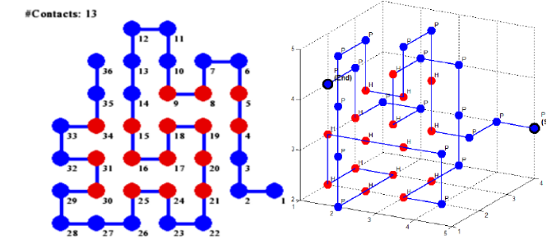
2. Extended Heuristic Algorithm Plus
Based on Traykov’s algorithm.
Divide chain S up into n parts S_{i} of predetermined length range.
‘Subchains’ should end on either H or C element depending on model.
Fold S₁ optimally against S₀ by going through all permutations (with self-avoidance), then fold S₂ optimally against S₀ ∪ S₁, etc. up until S_{n}.
Folds with equal stability have a chance to be accepted.
Source: Traykov, Metodi, et al. "Algorithm for protein folding problem in 3D lattice HP model." International Journal of Biology and Biomedicine 3 (2018).

Slide 8
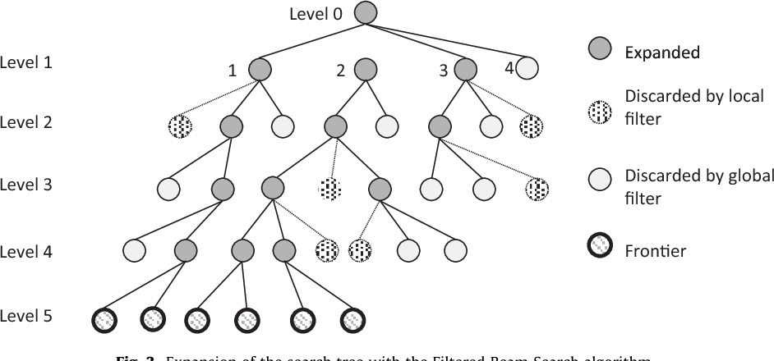
2. Breadth-first: Beam Search
Combination of breadth-first and greedy.
Goes through all moves from {u, d, l, r, i, o} and selects the n best moves (based on ‘beam width’).
Beam Search based on stability
On successive P elements, throw x% of permutations out.

Slide 9
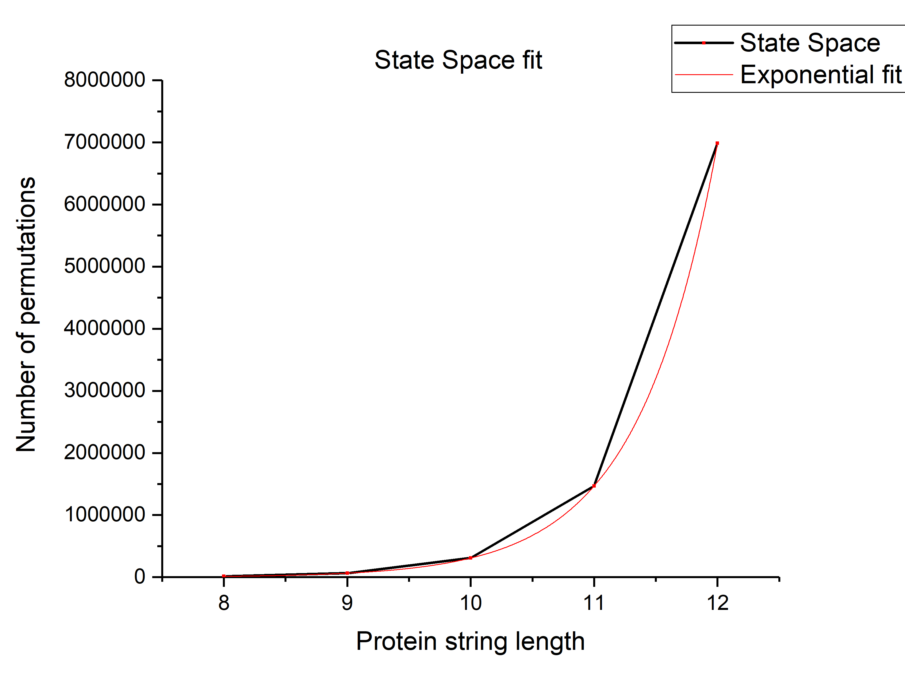

3. Results – State Space check
Using breadth first algorithm
Fit: $N=A∙e^{R∙n}$
N: number of permutations
A: 0.051 ± 0.001
R: 1.560 ± 0.001
n: protein chain length

Slide 10
3. Results – State Space check
Using extrapolation
5^{n-2} for 3D
n: protein chain length
Protein string length | Calculated state space | Extrapolated state space | Overestimation
8 | 15625 | 13565 | 15%
14 | 244140625 | 155797922 | 56%
20 | 3.8147E+12 | 1.8095E+12 | 110%
36 | 5.8208E+23 | 1.2518E+23 | 365%
50 | 3.5527E+33 | 3.8242E+32 | 829%

Slide 11
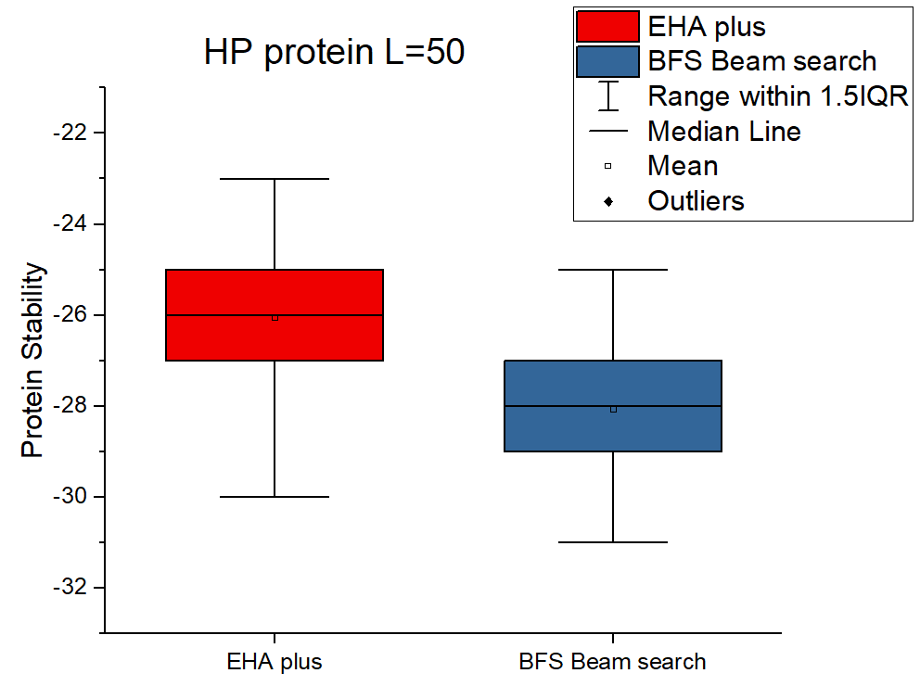
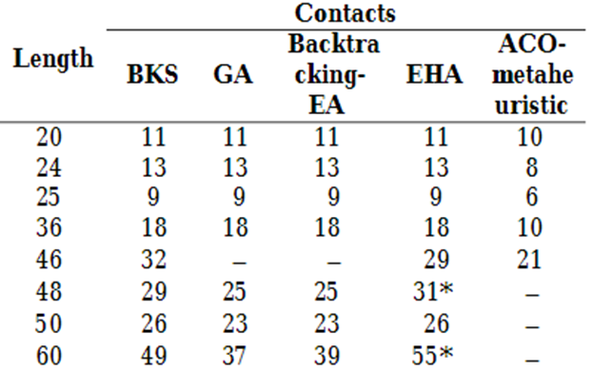
3. Results – HP Protein 3D
Results from literature
Source: Traykov, Metodi, et al. "Algorithm for protein folding problem in 3D lattice HP model." International Journal of Biology and Biomedicine 3 (2018).

Slide 12
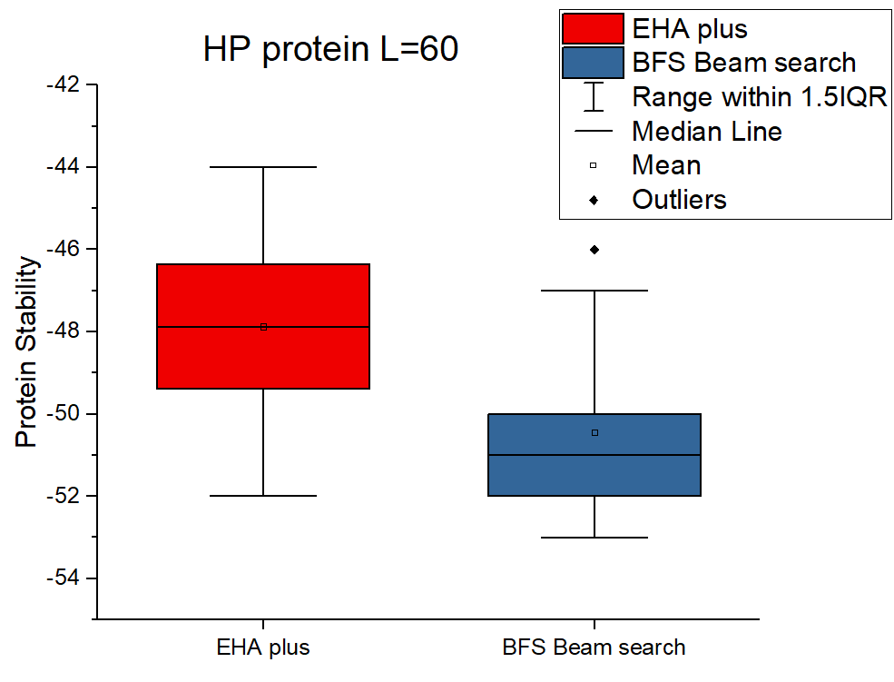
3. Results – HP Protein 3D
Results from literature
Source: Traykov, Metodi, et al. "Algorithm for protein folding problem in 3D lattice HP model." International Journal of Biology and Biomedicine 3 (2018).

Slide 13
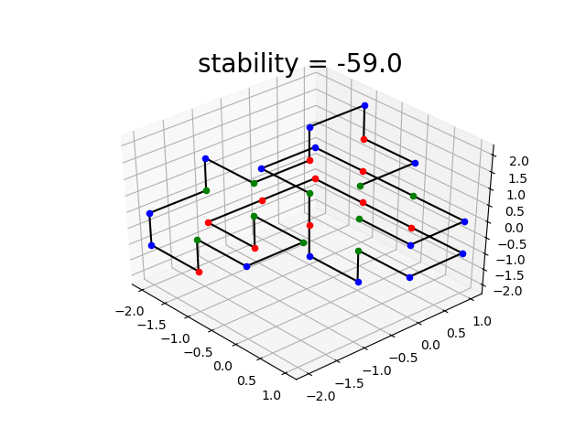
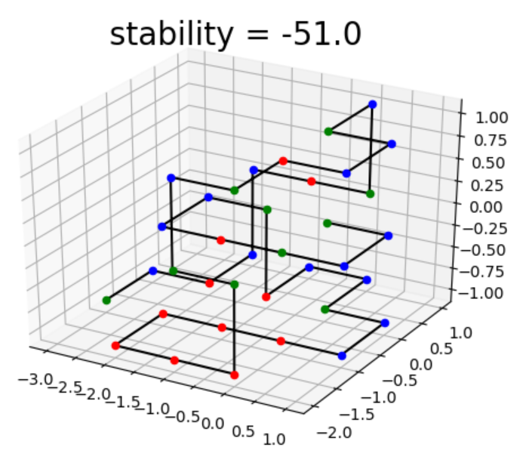
4. Discussion
HPC protein without random pruning
HPC protein with random pruning
Breadth first without random pruning results in a lower stability
Achieved BKS on all proteins besides HP protein L=60

Slide 14
5. Conclusion
HP protein L=50 3D | Best Known Solution (BKS) | EHA plus | Breadth-first search with beam search
Average Stability | - | -26 | -28
Best Stability | -26 | -30 | -31
Run Time | - | < 1 min | < 30 sec
HP protein L=60 3D | Best Known Solution (BKS) | EHA plus | Breadth-first search with beam search
Average Stability | - | -48 | -50
Best Stability | -55 | -52 | -53
Run Time | - | < 20 min | < 30 sec

Slide 15
Questions and comments?
Thank you for your attention

Slide 16
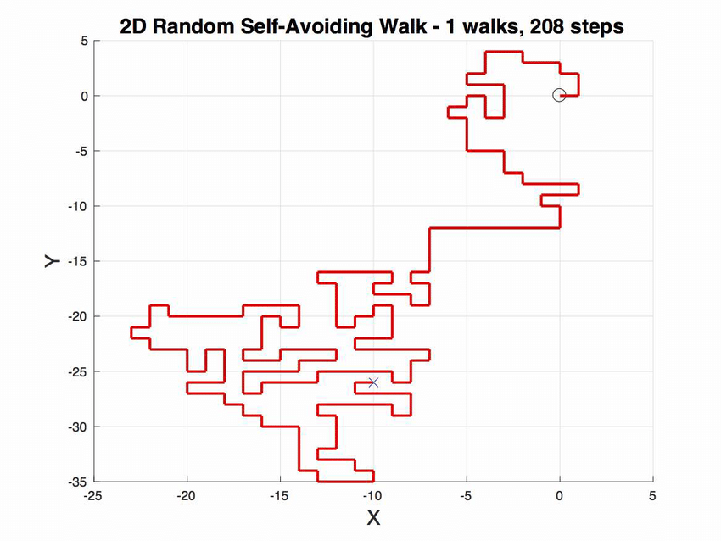
2. Self avoiding random walk
Let S be HP-chain of length n.
Fix first 2 elements of chain.
For subsequent elements up to the n^{th} element, choose random move from {u, d, l, r, i, o}.
If newly chosen coordinates are occupied, try new move.
Stuck? Start over.

Slide 17
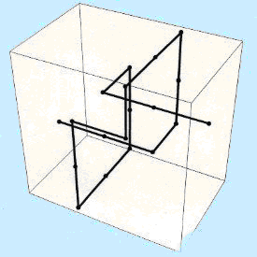
2. Self avoiding random walk (with a twist)
Let S be HP-chain of length n.
Fix first 2 elements of chain.
For subsequent elements up to the n^{th} element, choose random move from {u, d, l, r, i, o}.
If newly chosen coordinates are occupied, try new move.
If newly chosen coordinates are on the border, try new move.
Stuck? Start over.

Slide 18
2. Greedy
Let S be HP-chain of length n.
Fix first 2 elements of chain.
For subsequent elements, try all moves from {u, d, l, r, i, o} and check whether move would result in H-H connection (with self-avoidance).
If so, use the move. If not, pick random.
Stuck? Start over.

Slide 19
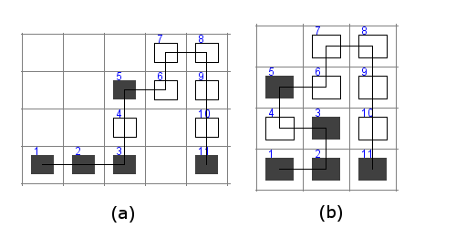
2. Hill Climber (Pull moves) + Sim Annealing
Iterative algorithm.
Starts with a solution.
Goes through the solution and tries to pull an elements diagonally to increase stability.
Better stability -> new solution.
Worse or equal stability -> x% chance of acceptance.
Repeat until stability converges.
Source: Chira, Camelia. "Hill-climbing search in evolutionary models for protein folding simulations." Stud Univ Babe\c s-Bolyai Inform 55 (2010): 29-40.

Slide 20
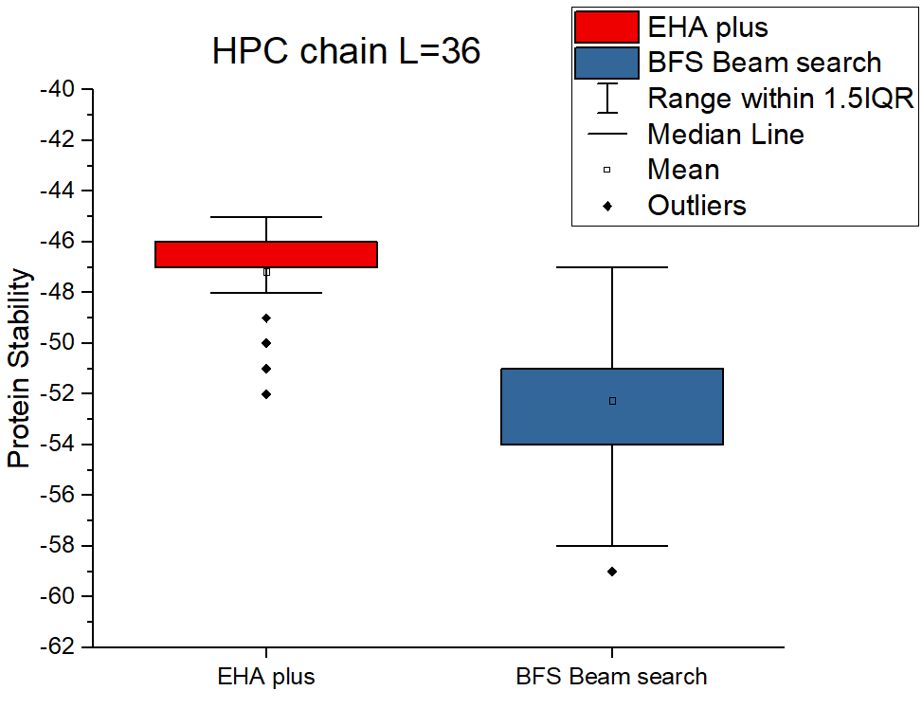
3. Results – HPC Protein 3D

Slide 21
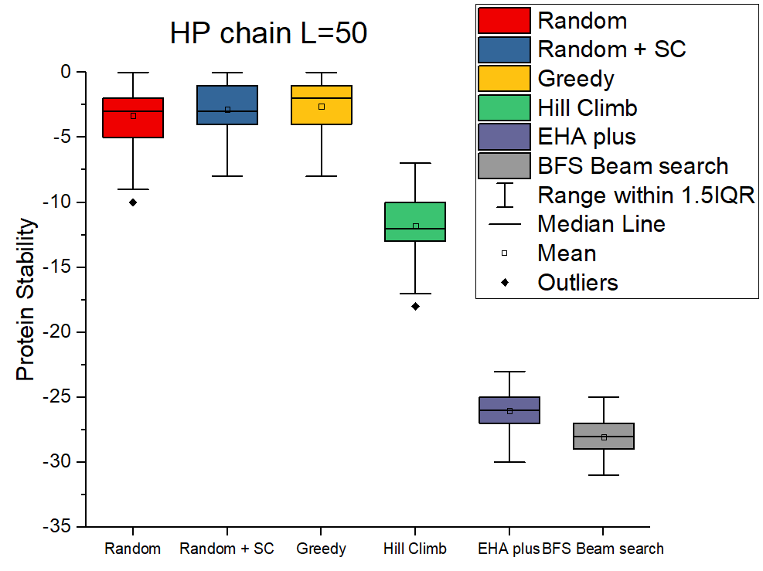
3. Results – HP Protein 3D all algorithms

Slide 22
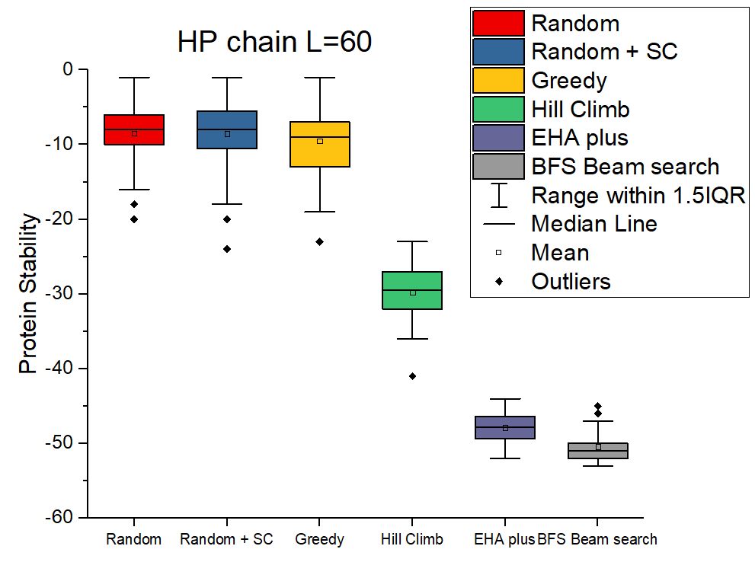
3. Results – HP Protein 3D all algorithms

Slide 23
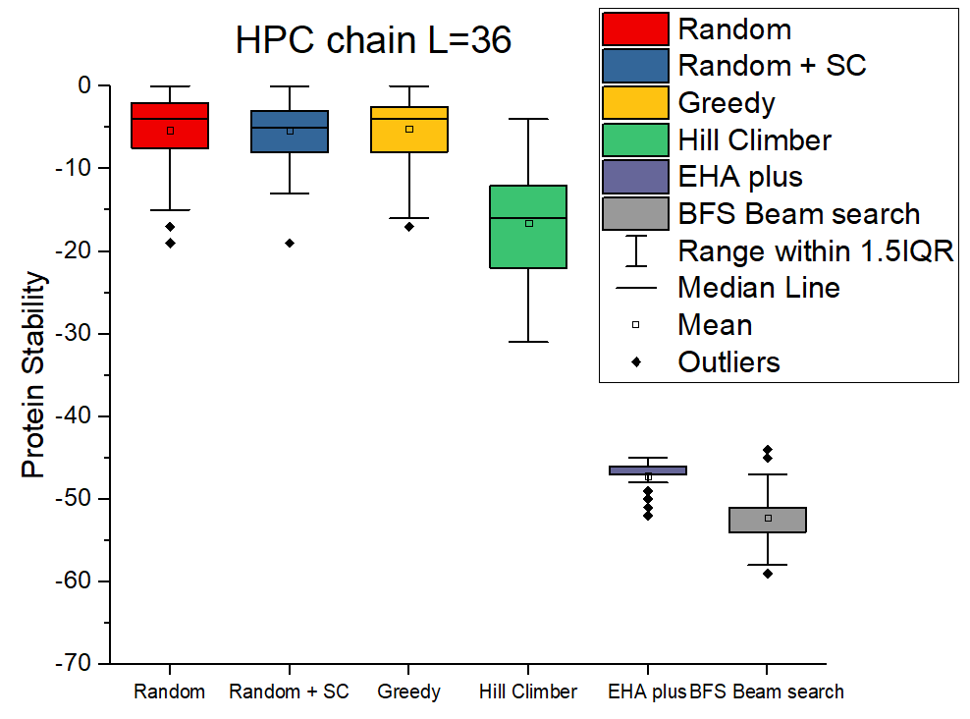
3. Results – HPC Protein 3D all algorithms

